Slide 1
Literature Circle Final Project Presentation example
Book: Dragons of Autumn Twilight

Slide 2
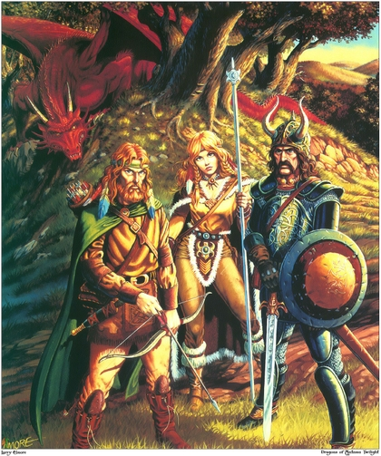
Big Moment #1: Goldmoon and Hederick, the High Theocrat
Reunion of the Companions
Goldmoon and Riverwind
Hederick the High Theocrat
The Blue Crystal Staff
Escaping the Inn of the Last Home
The Call to Adventure
Do Five (5) Big Moment Slides like these

Slide 3
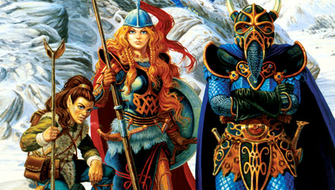
Character Analyst #1: Laurana
Elven Princess and Daughter of the Speaker of the Suns
Infatuation with Tanis, the leader of the Companions
Spoiled, naive, innocent, untested in battle
Becomes stronger after Tanis leaves her, eventually becomes the leader of the Dragonarmies and a dragon rider
Tanis and her relationship
Archetypes: Damsel in Distress, Innocent, Princess Classic, Princess Warrior, The Mother-Figure, Little Sister, Rebel Leader, The Majestic Lady, Character w/ Familiar
Do Five (5) Character Analyst Slides like these

Slide 4
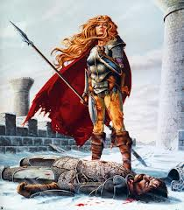
Moral Compass Topic: Friendship
Theme #1: Friendship means sacrificing everything, even your own life, if necessary
Examples
Flint, the dwarf, almost drowns in Crystalmir Lake because he won’t leave his friends to fight the goblins
Tas, the thief, almost burns to death in the wicker dragon saving his friends from the draconians
Raistlin, the mage, allows the Spectral Minions to use him as a mouthpiece to speak to the companions even though they don’t even trust him.
Tanis Half-Even endangers his own life fighting the Giant Slug when Laurana shows up unexpectedly
Do Five (5) Moral Compass Slides like these

Slide 5
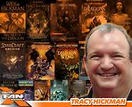
Author Expert: Author Background
Tracy Hickman
Born in Utah and attended Provo High School. Served a mission to Indonesia.
Approached Dungeons and Dragons about buying two of their modules and ended up starting to write for them with Weis
Co-authored over 40 books with Margaret Weis, including Dragonlance Chronicles, which are novels created to develop characters for Dungeons and Dragons
Wrote a novelization of the PC game Starcraft and a DC Batman Comic
Coming to Comic-Con next week!

Slide 6
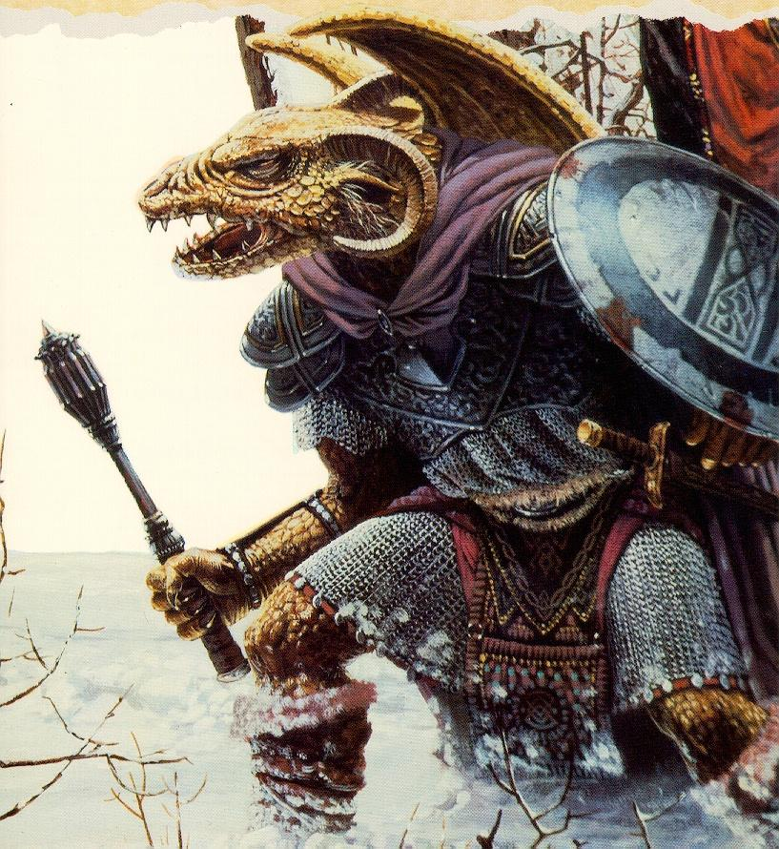
Author Expert: Dragons of Autumn Twilight
The Good
The beginning of the story is movie-worthy
Characters were complicated and conflicted.
The Plot was compelling and we wanted to read the sequels.
I loved the concept of the Draconians
I loved that Hickman and Weis gave the dragons personalities and a point of view and allowed them to speak and interact with the other characters
Easy Read
The Elves, the Forestmaster (Unicorn), Dark Elf, Laurana, Sturm, Tas, and the Dragonlance
Do Five (5) Good, Bad, and Ugly Slides like these

Slide 7
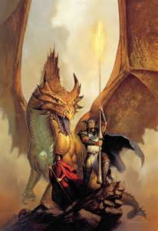
Author Expert: Dragons of Autumn Twilight
The Bad
Plot and Characterization were predictable.
Story was created for Dungeons and Dragons tabletop games so the story is pretty vanilla
Story has never been made into a movie, unless you accept this abomination as a movie: https://www.youtube.com/watch?v=UHrOfJ8_D0o
There was some content
The other stories in the world are not as good.
Do Five (5) Good, Bad, and Ugly Slides like these

Slide 8
Final thoughts: Dragons of Autumn twilight
Final Thoughts
Fun Casting List: https://www.youtube.com/watch?v=T8Hh3NEKjNY

