Slide 1
Historical Background on the Jewish Holocaust
Video Presentation
Night Unit
World Literature
Notes:
(All movie clips for ppt. on accompanying flash drive).

Slide 2
Holocaust Defined
Holocaust is defined as “a fire that causes total destruction.”
No one before Hitler had ever tried to murder an entire group of people (at least that we know of).
Hitler’s crime provided dictionaries with a new word: Genocide. A genocide is the planned killing of an entire cultural or racial group of people.
Notes:
The term has been used to describe the mass killings by the Nazis because the genocide was like a great fire burning everything and everyone in its path.

Slide 3
Anti-Semitism
Hitler was not the original hater of the Jews
Greeks and Romans anciently were anti-Jew
Jews were blamed by Christians for having crucified Jesus Christ—this is where their “evil” image originated.
The Black Plague struck Europe in 1347. Many Europeans blamed the Jews, obviously undeservingly.
Many Jews had to take up moneylending, an unscrupulous trade, because they were considered outcasts. This only reinforced them as evil and selfish.

Slide 4
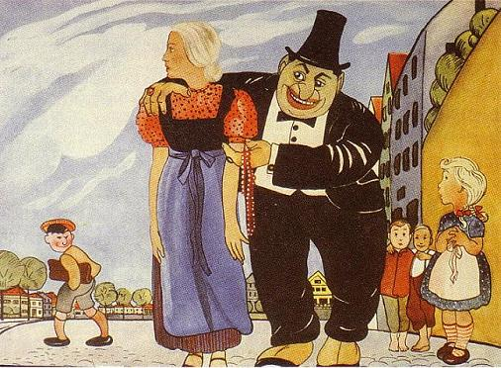
Anti-Semitic Propaganda

Slide 5
The Reality of the Jews
Many of the successful, well-to-do Germans were Jews.
Jews, as a group, were prospering as a people among the Germans.
Jews were very religious and their spirituality was a positive aspect, not a negative aspect.
Jews were law-abiding, honorable citizens. Good neighbors, and hard-working.
Jews were resilient due to their past history

Slide 6
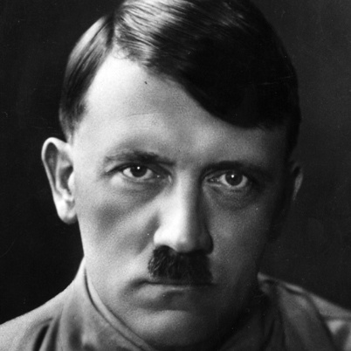
Hitler, the Failure
He was jealous of successful Jewish men and women because he, himself was unemployed and uneducated.
Refused to get a job
He had visions of being a great artist or architect
High School Dropout
Hitler needed a scapegoat for his failures so he blamed his lack of interest in school on his father and his teachers. He said that he deliberately failed his studies to get even with his father. He called teachers “boring” and “stupid.” The truth was that he was a spoiled child.

Slide 7
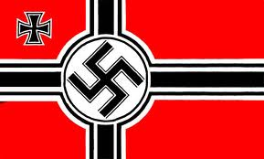
The Nazi Creed
Hitler hired a private army to overthrow the German government. He called them “stormtroopers,” yet they were just angry ex-soldiers, common criminals, and cutthroats.
Hitler was imprisoned for trying to take over Munich by force; there he dictated his ideas about Nazism to fellow prisoners who were dropouts like himself. After eight months in prison, he was released and a publisher edited his ideas into a book called Mein Kampf.
After Hitler came to power, every German household was required to have a copy in their home. Most were never read. This is a sad and scary fact, for in the book Hitler revealted his plans to be the future warlord and dictator of Germany.

Slide 8
The Premise of Mein Kampf
Men are not created equal. Germans are the most superior race on Earth. Aryan blood must remain pure.
Jews are the most inferior race. The Germans must exterminate them.
Blacks, invalids, people with disabilities, homosexuals, Jehovah Witnesses, and gypsies are only slightly above Jews in inferiority.
Germany must take as much land to the east as possible. If others resist, Germany will take the land by force.
Democracy and majority rule are stupid. The masses are ignorant and need the Nazi government and Hitler to lead them.
Propaganda must be used to teach the ignorant.
Force and fear are the only means to control the masses.
The Jews are to blame for everything evil and should be hated.
Christianity is a joke. Love, mercy, and charity must be replace by pride, willpower, defiance, and hate if Germany is to become all-powerful.

Slide 9
Show Hitler in “Downfall” tantrum

Slide 10
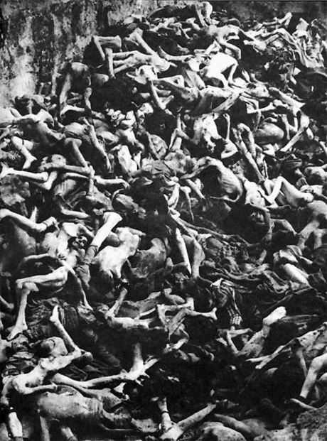
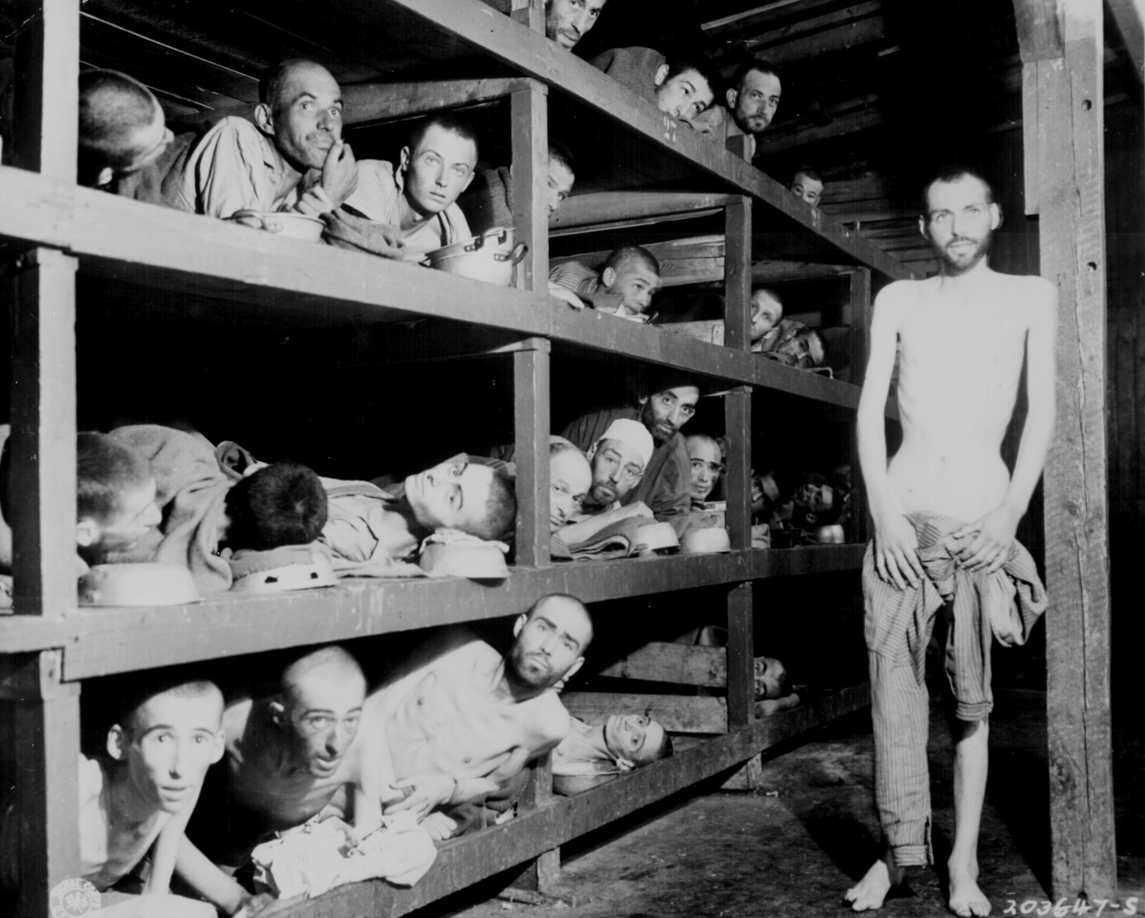
The Final Solution

Slide 11
The Great Depression of 1929-1933
Opened the doors to Nazism
Misery and starvation spread all over Germany
The people wanted hope and Hitler game them a vision of a great Germany again.
Hitler is consequently named German chancellor in 1933.

Slide 12
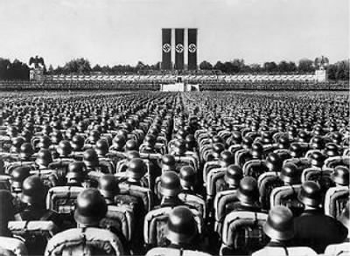
Terror State
Hitler taught youth that education was not important and that girls did not need to get married. They should have kids whenever they want.
Hitler wrecked the school system and turns it into a training center for Nazism.
By the time Hitler was finished, some German youth had become so brainwashed, actually turned their anti-Nazi parents in to be jailed.
Hitler attacked Chrisianity
The swastika replaces all crucifixes in churches
The bible is to be banned in Germany
Religious book burnings
Hitler burned tens of thousands of other books to ashes

Slide 13
Show Hitler youth clip from Der Untergang

Slide 14
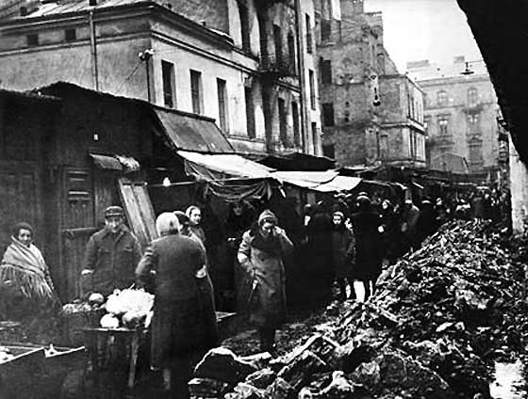
The Ghettos
Once in power, Hitler decided to round up the Jews into larger cities with access to major railroad lines. This would help the Germans more easily send the Jews away.
The Nazis set up ghettos in these cities to hold all of the Jews. They were deliberately starved and could receive no medical help in the camps.

Slide 15
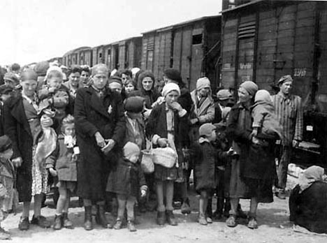
Deportation
Eventually Jews were deported from the ghettos and transported to one of the multitude of work and death camps available to them. They traveled in cattle cars or wagons.
These wagons did not have water, food, a toilet, or ventilation. Sometimes there were not enough cars for a major transport, so victims waited at a switching yard, often with standing room only, for several days. The longest transport of the war took 18 days. When the transport doors were open, everyone was already dead.

Slide 16
Show deportation clip from Schindler’s List

Slide 17
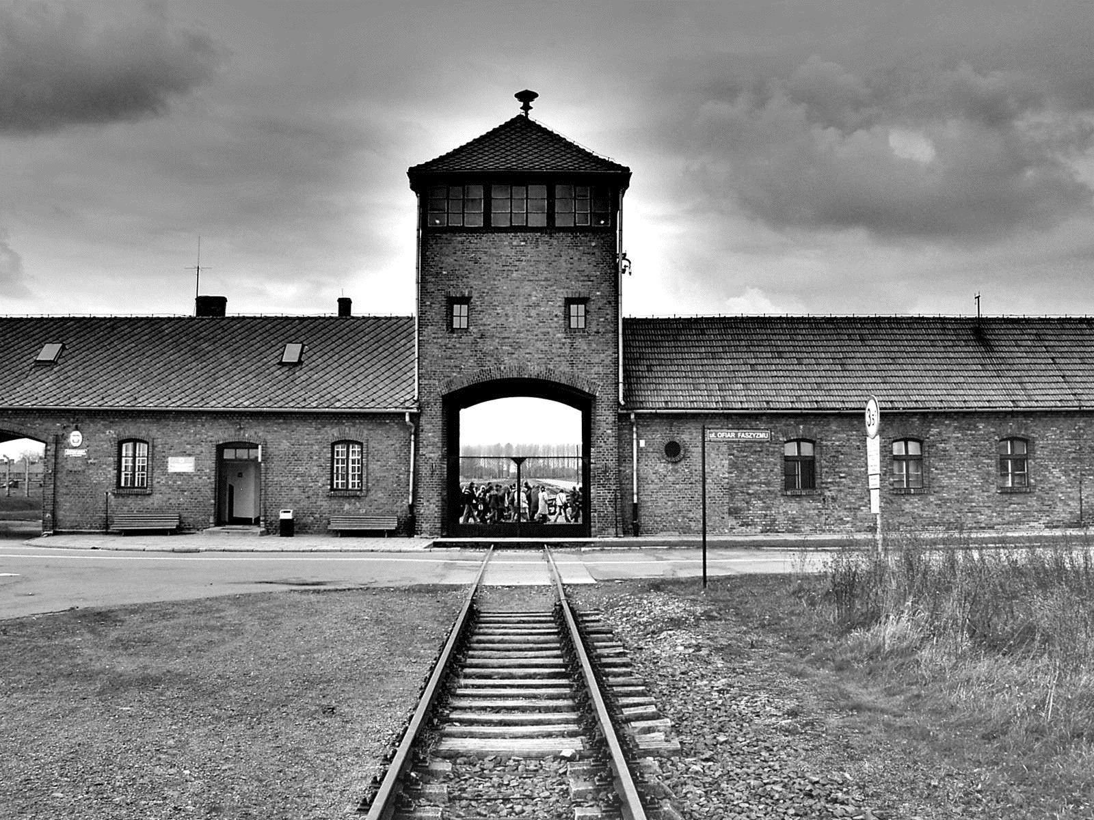
Concentration Camps

Slide 18
Concentration vs. Death Camps
There were actually a number of different kinds of camps, including concentration camps, extermination/death camps, labor camps, prisoner-of-war camps, and transit camps.
A death or extermination camp had no barracks. Only gas chambers and crematoriums. A concentration camp had a place for workers/survivors to stay.
Auschwitz, the largest camp, was both a death camp and concentration camp.

Slide 19
Step One: Selection
The selection procedure carried out on the ramps was as follows: families were divided after leaving the train cars and all the people were lined up in two columns. The men and older boys were in one column, and the women, elderly, and children of both sexes in the other. Next, the people were led to the camp doctors and other camp functionaries conducting selection. They judged the people standing before them on sight and, sometimes eliciting a brief declaration as to their age and occupation, decided whether they would live or die.
Age was one of the principal criteria for selection. As a rule, all children below 16 years of age (from 1944, below 14) and the elderly over 50 were sent to die.

Slide 20
Show Selection clip in War & Remembrance

Slide 21
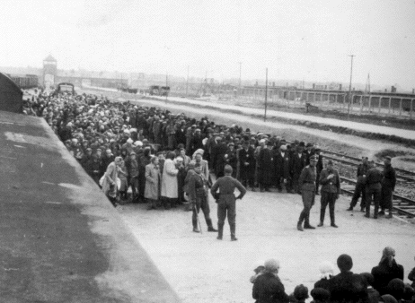
Why Selection?
The Weak
Separated Families
Gave the Germans more workers to help them in the war efforts

Slide 22
Step Two: Gas Chambers
Nazis would trick Jews into the gas chambers
Carbon monoxide was originally used in gas chambers. Later, the insecticide Zyklon B was developed to kill inmates. Victims would scream and fight for their lives because it was so painful to die this way.
Sonderkommando would be in charge of excavating the bodies from the gas chambers.

Slide 23
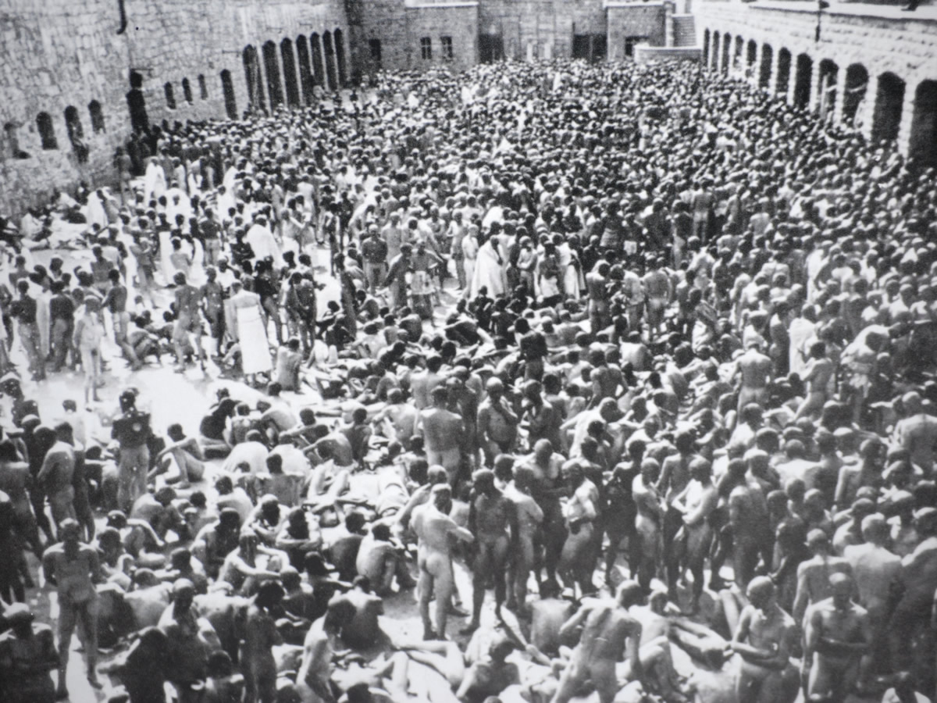
Gas Chambers

Slide 24
Why the Gas Chambers?
Quicker
Easier
Mass extermination
Much cheaper than bullets

Slide 25
Show Gas chambers clip from The Boy in Striped Pajamas

Slide 26
Step Three: Crematoriums
Sonderkammando would take the bodies to huge ovens called crematoriums.
Here they would burn the bodies.
It wasn’t always this way. Before Hitler perfected the extermination process, the Sonderkammando would dig huge graves and throw the bodies in there.

Slide 27
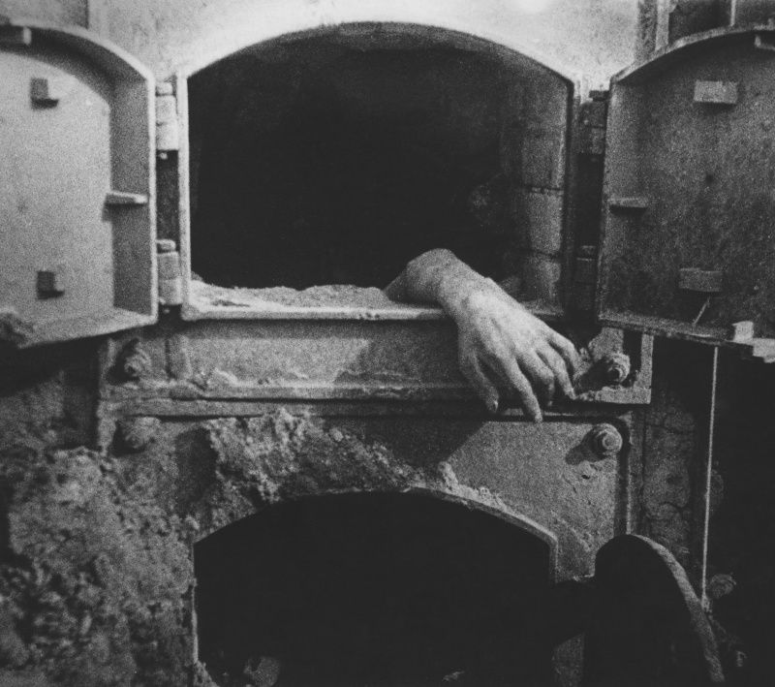
Crematoriums

Slide 28
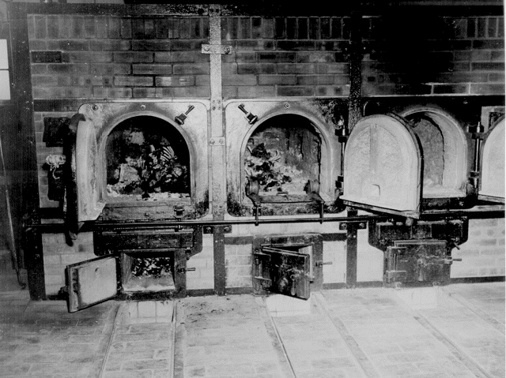
Why Crematoriums?
Less space
Quicker
Easier
No evidence

Slide 29
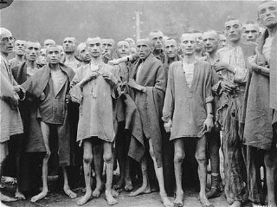
Life in the Concentration Camps

Slide 30
If you survived Selection, you could look forward to… (in the concentration camps)
Brutal, Frigid conditions
Mismatched clothes that didn’t fit
Poorly fitting or made shoes
Meager amount of food
Torture
Bullying and Abuse
Extremely physically taxing work
No family or friends
No entertainment or amusement
Watching the people you DO get to know die
Burying or burning other victims
Running 50 miles in one day without stopping or eating
Dysentery
Disease
Illness
Violent overseers
Horrible housing—living with three other people in a tight space
Eventual death

Slide 31
Show Concentration Camp clip from “Life is Beautiful”

Slide 32
Dr. Mengele’s Experiments
Mengele would often conduct sadistic experiments on women and children. He studied:
Twins
Handicaps
Deformities
Eye coloring
Sterility and Fertility
The experiments, although cruel, brutal, and absolutely despicable, have helped modern scientists today to understand many mysteries unknown before Mengele did his research, sadly enough.

Slide 33
The Resistance
People did fight back. Jews resisted in many ways. They stole food, sabotaged weapons and machines, and stockpiled weapons. Occasionally, they fought back, too.
However, many Jews did NOT fight back for many reasons. They wanted to protect their families, their religious convictions held them back, and they were so starved and weary from labor that they had no desire to resist.
Warsaw Ghetto Revolt—1,000 Nazi soldiers died. Nazi tanks and over 3,000 Nazi soldiers were repelled by 400 Jewish resistance fighters using the attics of the ghetto homes. After 28 days, over 15,000 Jews had died after they refused to surrender.

Slide 34
Liberation of the Concentration Camps
Most concentration camps were liberated by 1945. British, American, and allied forces freed the victims. Nevertheless, their efforts were too late for 11 million Holocaust victims.
Most camps were decimated. The survivors were sick, diseased, malnourished, or close to death themselves.
Many soldiers did not know what they were seeing. They weren’t prepared for the death camps.

Slide 35
Show Liberation from Band of Brothers

Slide 36
Victims of the Holocaust
It is estimated that 11 million people were killed during the Holocaust. Six million of these were Jews.
The Nazis killed approximately two-thirds of all Jews living in Europe.
An estimated 1.1 million children were murdered in the Holocaust.

Slide 37
Final Thoughts and Questions

Slide 38
Quote in the Holocaust Memorial in Washington, D.C.
First they came for the Socialists, and I did not speak out - because I was not a Socialist.
Then they came for the Trade Unionists, and I did not speak out - because I was not a Trade Unionist.
Then they came for the Jews, and I did not speak out -
because I was not a Jew.
Then they came for me - and there was no one left to speak for me.

Slide 39
Writer’s Notebook #23: Why do we read and talk about the Jewish Holocaust? What were some of the things that Hitler taught or got rid of in German society that might be similar in our society?

